Slide 1
PHP
Basics

Slide 2
Introduction
PHP stands for Hypertext Preprocessor.
PHP is a very popular and widely-used open source server-side scripting language to write dynamically generated web pages.
PHP scripts are executed on the server and the result is sent to the web browser as plain HTML.
PHP can be integrated with the number of popular databases, including MySQL, PostgreSQL, Oracle, Microsoft SQL Server, Sybase, and so on.
The current major version of PHP is 7.

Slide 3
What You Can Do with PHP
You can generate pages and files dynamically.
You can create, open, read, write and close files on the server.
You can collect data from a web form such as user information, email, phone no, etc.
You can send emails to the users of your website.
You can send and receive cookies to track the visitor of your website.
You can store, delete, and modify information in your database.
You can restrict unauthorized access to your website.
You can encrypt data for safe transmission over internet.

Slide 4
Advantages of PHP over Other Languages
Easy to learn
Open source
Portability
Fast Performance
Vast Community

Slide 5
PHP Syntax
PHP script starts with the <?php and ends with the ?> tag.
<?php // Some code to be executed
echo
"Hello, world!";
?>
Every PHP statement end with a semicolon (;) — this tells the PHP engine that the end of the current statement has been reached.

Slide 6
Getting Started with PHP
Setting Up a Local Web Server: PHP script execute on a web server running PHP. So before you start writing any PHP program you need the following program installed on your computer.
The Apache Web server
The PHP engine
The MySQL database server
Note: WampServer is a Windows web development environment. It allows you to create web applications with Apache2, PHP and a MySQL database. It will also provide the MySQL administrative tool PhpMyAdmin to easily manage your databases using a web browser.

Slide 7
Creating Your First PHP Script
Open up your favourite code editor and create a new PHP file then type the following code:
<?php // Display greeting message echo
"Hello, world!";
?>
Now save this file as "hello.php" in your project folder (located at C:\wamp\www\project),
and view the result in your browser through visiting this URL: http://localhost/project/hello.php

Slide 8
Creating Your First PHP Script
PHP can be embedded within a normal HTML web page. That means inside your HTML document you can write the PHP statements, as demonstrated in the following example:
<!DOCTYPE HTML>
<html> <head>
<title>PHP Application</title> </head>
<body>
<?php // Display greeting message echo
'Hello World!';
?>
</body> </html>

Slide 9
PHP Comments
A comment is simply text that is ignored by the PHP engine. The purpose of comments is to make the code more readable.
PHP support single-line as well as multi-line comments.
To write a single-line comment either start the line with either two slashes (//) or a hash symbol (#).

Slide 10
Case Sensitivity in PHP
Variable names in PHP are case-sensitive.
As a result the variables $color, $Color and $COLOR are treated as three different variables.

Slide 11
PHP Variables
Variables are used to store data, like string of text, numbers, etc. Variable values can change over the course of a script. Here're some important things to know about variables:
In PHP, a variable does not need to be declared before adding a value to it. PHP automatically converts the variable to the correct data type, depending on its value.
After declaring a variable it can be reused throughout the code.
The assignment operator (=) used to assign value to a variable.

Slide 12
PHP Variables
In PHP variable can be declared as: $var_name = value;
Example:
<?php // Declaring variables
$txt = "Hello World!";
$number = 10; // Displaying variables value
echo $txt; // Output: Hello World!
echo $number; // Output: 10
?>

Slide 13
Naming Conventions for PHP Variables
These are the following rules for naming a PHP variable:
All variables in PHP start with a $ sign, followed by the name of the variable.
A variable name must start with a letter or the underscore character _.
A variable name cannot start with a number.
A variable name in PHP can only contain alpha-numeric characters and underscores (A-z, 0-9, and _).
A variable name cannot contain spaces.

Slide 14
PHP Constants
A constant is a name or an identifier for a fixed value. Constant are like variables except that one they are defined, they cannot be undefined or changed (except magic constants). [Magic Constants will be covered under advanced PHP]
Constants are defined using PHP's define() function, which accepts two arguments: the name of the constant, and its value.
Name of constants must follow the same rules as variable names, which means a valid constant name must starts with a letter or underscore, followed by any number of letters, numbers or underscores with one exception: $ prefix is not required for constant names.

Slide 15
PHP Echo Statements
The echo statement can output one or more strings.
The echo statement can display anything that can be displayed to the browser, such as string, numbers, variables values, the results of expressions etc.
Echo is a language construct not actually a function (like if statement), you can use it without parentheses e.g. echo or echo()

Slide 16
The PHP print Statement
The print statement (an alternative to echo) to display output to the browser. Like echo the print is also a language construct not a real function. So it can also be used without parentheses like: print or print().
Example
<?php // Displaying string of text print
"Hello World!";
?>

Slide 17
PHP Data Types
The values assigned to a PHP variable may be of different data types including simple string and numeric types to more complex data types like arrays and objects.
PHP supports total eight primitive data types: Integer, Floating point number or Float, String, Booleans, Array, Object, resource and NULL.
These data types are used to construct variables.

Slide 18
PHP Integers
Integers are whole numbers, without a decimal point (..., -2, -1, 0, 1, 2, ...).
Integers can be specified in
decimal (base 10)
hexadecimal (base 16 - prefixed with 0x)
octal (base 8 - prefixed with 0), optionally preceded by a sign (- or +).

Slide 19
PHP Strings
Strings are sequences of characters, where every character is the same as a byte.
A string can hold letters, numbers, and special characters and it can be as large as up to 2GB (2147483647 bytes maximum).
The simplest way to specify a string is to enclose it in single quotes (e.g. 'Hello world!'), however you can also use double quotes ("Hello world!").

Slide 20
PHP Floating Point Numbers or Doubles
Floating point numbers (also known as "floats", "doubles", or "real numbers") are decimal or fractional numbers, like demonstrated in the example below:
<?php $a = 1.234;
var_dump($a);
echo "<br>";
$b = 10.2e3;
var_dump($b);
echo "<br>";
$c = 4E-10;
var_dump($c);
?>

Slide 21
PHP Booleans
Booleans are like a switch it has only two possible values either 1 (true) or 0 (false).
<?php // Assign the value TRUE to a variable
$show_error = true;
var_dump($show_error);
?>

Slide 22
PHP Arrays
An array is a variable that can hold more than one value at a time. It is useful to aggregate a series of related items together, for example a set of country or city names.
An array is formally defined as an indexed collection of data values. Each index (also known as the key) of an array is unique and references a corresponding value.

Slide 23
Array Example
<?php $colors = array("Red", "Green", "Blue");
var_dump($colors);
echo "<br>";
$color_codes = array( "Red" => "#ff0000", "Green" => "#00ff00", "Blue" => "#0000ff" );
var_dump($color_codes);
?>

Slide 24
PHP Objects
An object is a data type that not only allows storing data but also information on, how to process that data.
An object is a specific instance of a class which serve as templates for objects. Objects are created based on this template via the new keyword.
Every object has properties and methods corresponding to those of its parent class. Every object instance is completely independent, with its own properties and methods, and can thus be manipulated independently of other objects of the same class.

Slide 25
Example of Objects
<?php // Class definition
class greeting{
// properties
public $str = "Hello World!";
// methods
function show_greeting(){
return $this->str; } }
// Create object from class
$message = new greeting;
var_dump($message); ?>

Slide 26
PHP NULL
The special NULL value is used to represent empty variables in PHP. A variable of type NULL is a variable without any data. NULL is the only possible value of type null.
<?php $a = NULL;
var_dump($a);
echo "<br>";
$b = "Hello World!";
$b = NULL;
var_dump($b); ?>
When a variable is created without a value in PHP like $var; it is automatically assigned a value of null

Slide 27
PHP Resources
A resource is a special variable, holding a reference to an external resource.
Resource variables typically hold special handlers to opened files and database connections.
<?php // Open a file for reading
$handle = fopen("note.txt", "r");
var_dump($handle);
echo "<br>"; // Connect to MySQL database server with default setting
$link = mysql_connect("localhost", "root", "");
var_dump($link); ?>

Slide 28
PHP Strings
A string is a sequence of letters, numbers, special characters and arithmetic values or combination of all. The simplest way to create a string is to enclose the string literal (i.e. string characters) in single quotation marks ('),
like this: $my_string = 'Hello World';

Slide 29
Manipulating PHP Strings
PHP provides many built-in functions for manipulating strings like calculating the length of a string, find substrings or characters, replacing part of a string with different characters, take a string apart, and many others.
Calculating the Length of a String: strlen() function is used to calculate the number of characters inside a string. It also includes the blank spaces inside the string.
Counting Number of Words in a String: The str_word_count() function counts the number of words in a string.

Slide 30
Continue..
Replacing Text within Strings: The str_replace() replaces all occurrences of the search text within the target string.
Reversing a String: The strrev() function reverses a string.

Slide 31
PHP Operators
Operators are symbols that tell the PHP processor to perform certain actions.
For example, the addition (+) symbol is an operator that tells PHP to add two variables or values, while the greater-than (>) symbol is an operator that tells PHP to compare two values.

Slide 32
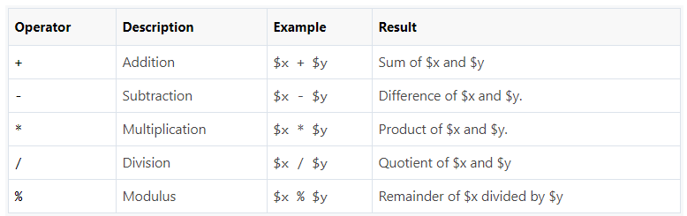
PHP Arithmetic Operators
The arithmetic operators are used to perform common arithmetical operations, such as addition, subtraction, multiplication etc.

Slide 33
Example
<?php
$x = 10;
$y = 4;
echo($x + $y); // 0utputs: 14
echo($x - $y); // 0utputs: 6
echo($x * $y); // 0utputs: 40
echo($x / $y); // 0utputs: 2.5
echo($x % $y); // 0utputs: 2
?>

Slide 34
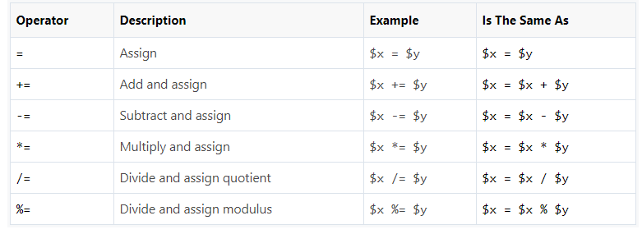
PHP Assignment Operators
The assignment operators are used to assign values to variables.

Slide 35
Example
<?php $x = 10; echo $x; // Outputs: 10 $x = 20; $x += 30; echo $x; // Outputs: 50 $x = 50; $x -= 20; echo $x; // Outputs: 30 $x = 5; $x *= 25; echo $x; // Outputs: 125
$x = 50; $x /= 10; echo $x; // Outputs: 5 $x = 100; $x %= 15; echo $x; // Outputs: 10 ?>

Slide 36
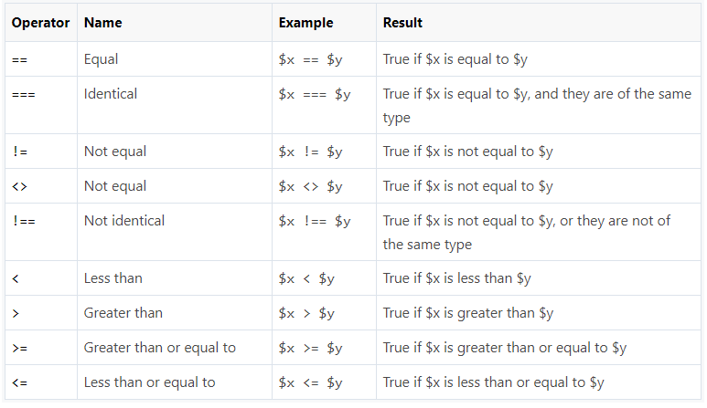
PHP Comparison Operators

Slide 37
Example
<?php
$x = 25;
$y = 35;
$z = "25";
var_dump($x == $z); // Outputs: boolean true
var_dump($x === $z); // Outputs: boolean false
var_dump($x != $y); // Outputs: boolean true
var_dump($x !== $z); // Outputs: boolean true
var_dump($x < $y); // Outputs: boolean true
var_dump($x > $y); // Outputs: boolean false
var_dump($x <= $y); // Outputs: boolean true
var_dump($x >= $y); // Outputs: boolean false ?>

Slide 38
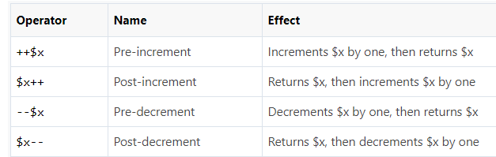
PHP Incrementing and Decrementing Operators

Slide 39
Example
<?php
$x = 10;
echo ++$x; // Outputs: 11
echo $x; // Outputs: 11
$x = 10;
echo $x++; // Outputs: 10
echo $x; // Outputs: 11
$x = 10;
echo --$x; // Outputs: 9
echo $x; // Outputs: 9
$x = 10;
echo $x--; // Outputs: 10
echo $x; // Outputs: 9 ?>

Slide 40
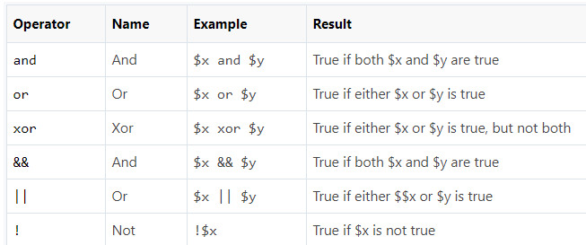
PHP Logical Operators

Slide 41
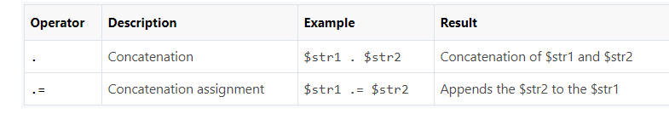
PHP String Operators

Slide 42
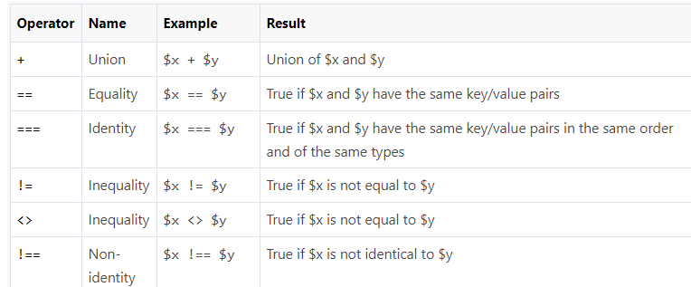
PHP Array Operators

Slide 43
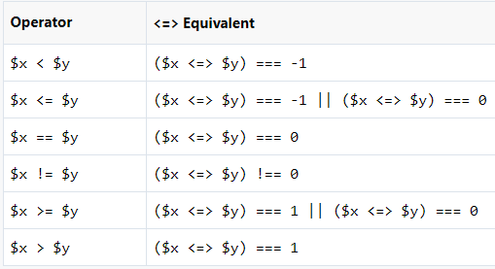
PHP Spaceship Operator
PHP 7 introduces a new spaceship operator (<=>)
which can be used for comparing two expressions.
It is also known as combined comparison operator.
The spaceship operator returns 0
if both operands are equal, 1 if the left is greater,
and -1 if the right is greater.
It basically provides three-way comparison.

Slide 44
Example
<?php // Comparing Integers echo 1 <=> 1; // Outputs: 0 echo 1 <=> 2; // Outputs: -1 echo 2 <=> 1; // Outputs: 1 // Comparing Floats echo 1.5 <=> 1.5; // Outputs: 0 echo 1.5 <=> 2.5; // Outputs: -1 echo 2.5 <=> 1.5; // Outputs: 1 // Comparing Strings echo "x" <=> "x"; // Outputs: 0 echo "x" <=> "y"; // Outputs: -1 echo "y" <=> "x"; // Outputs: 1 ?>

Slide 45
PHP If…Else Statements
The if statement is used to execute a block of code only if the specified condition evaluates to true. This is the simplest PHP's conditional statements and can be written like:
if(condition)
{ // Code to be executed
}

Slide 46
The if...else Statement
if(condition)
{ // Code to be executed if condition is true }
Else
{ // Code to be executed if condition is false }

Slide 47
The if...elseif...else Statement
if(condition1)
{ // Code to be executed if condition1 is true }
elseif(condition2)
{ // Code to be executed if the condition1 is false and condition2 is true }
Else
{ // Code to be executed if both condition1 and condition2 are false }

Slide 48
The Ternary Operator
The ternary operator provides a shorthand way of writing the if...else statements. The ternary operator is represented by the question mark (?) symbol and it takes three operands: a condition to check, a result for true, and a result for false.
<?php
if($age < 18){
echo 'Child'; // Display Child if age is less than 18}
else
{ echo 'Adult'; // Display Adult if age is greater than or equal to 18 } ?>

Slide 49
The Null Coalescing Operator
PHP 7 introduces a new null coalescing operator (??)
which you can use as a shorthand where you need to use a ternary operator in conjunction with isset() function.
Example:
<?php
$name = isset($_GET['name']) ? $_GET['name'] : 'anonymous';
?>

Slide 50
PHP Switch…Case Statements
switch(n)
{ case label1: // Code to be executed if n=label1
break;
case label2: // Code to be executed if n=label2
break;
...
default:
// Code to be executed if n is different from all labels
}

Slide 51
Switch Case –Important to Remember
The switch-case statement differs from the if-elseif-else statement in one important way.
The switch statement executes line by line (i.e. statement by statement)
Once PHP finds a case statement that evaluates to true, it's not only executes the code corresponding to that case statement, but also executes all the subsequent case statements till the end of the switch block automatically

Slide 52
PHP Arrays
Arrays are complex variables that allow us to store more than one value or a group of values under a single variable name. Let's suppose you want to store colors in your PHP script.
Types of Arrays in PHP: There are three types of arrays that you can create.
1. Indexed array — An array with a numeric key.
2. Associative array — An array where each key has its own specific value.
3. Multidimensional array — An array containing one or more arrays within itself.

Slide 53
Indexed Arrays
An indexed or numeric array stores each array element with a numeric index. The following examples shows two ways of creating an indexed array, the easiest way is:
<?php
// Define an indexed array
$colors = array("Red", "Green", "Blue");
?>

Slide 54
Associative Arrays
In an associative array, the keys assigned to values can be arbitrary and user defined strings. In the following example the array uses keys instead of index numbers:
<?php
// Define an associative array
$ages = array("Peter"=>22, "Clark"=>32, "John"=>28);
?>

Slide 55
Multidimensional Arrays
The multidimensional array is an array in which each element can also be an array and each element in the sub-array can be an array or further contain array within itself and so on.

Slide 56
Example
<?php // Define a multidimensional array $contacts = array( array( "name" => "Peter Parker", "email" => "peterparker@mail.com", ), array( "name" => "Clark Kent", "email" => "clarkkent@mail.com", ), array( "name" => "Harry Potter", "email" => "harrypotter@mail.com", ) ); // Access nested value echo "Peter Parker's Email-id is: " . $contacts[0]["email"]; ?>

Slide 57
PHP Loops
while — loops through a block of code until the condition is evaluate to true.
do…while — the block of code executed once and then condition is evaluated. If the condition is true the statement is repeated as long as the specified condition is true.
for — loops through a block of code until the counter reaches a specified number.
foreach — loops through a block of code for each element in an array.

Slide 58
PHP while Loop
The while statement will loops through a block of code until the condition in the while statement evaluate to true.
<?php
$i = 1;
while($i <= 3)
{
$i++;
echo "The number is " . $i . "<br>";
}
?>

Slide 59
PHP do…while Loop
The do-while loop is a variant of while loop, which evaluates the condition at the end of each loop iteration.
<?php
$i = 1;
do{
$i++;
echo "The number is " . $i . "<br>";
}
while($i <= 3);
?>

Slide 60
Difference Between while and do…while Loop
The while loop differs from the do-while loop in one important way — with a while loop, the condition to be evaluated is tested at the beginning of each loop iteration, so if the conditional expression evaluates to false, the loop will never be executed.
With a do-while loop, on the other hand, the loop will always be executed once, even if the conditional expression is false, because the condition is evaluated at the end of the loop iteration rather than the beginning.

Slide 61
PHP for Loop
The for loop repeats a block of code until a certain condition is met. It is typically used to execute a block of code for certain number of times.
The parameters of for loop have following meanings:
initialization — it is used to initialize the counter variables, and evaluated once unconditionally before the first execution of the body of the loop.
condition — in the beginning of each iteration, condition is evaluated. If it evaluates to true, the loop continues and the nested statements are executed. If it evaluates to false, the execution of the loop ends.
increment — it updates the loop counter with a new value. It is evaluate at the end of each iteration.

Slide 62
Example
<?php
for($i=1; $i<=3; $i++){
echo "The number is " . $i . "<br>";
}
?>

Slide 63
PHP foreach Loop
The foreach loop is used to iterate over arrays.
<?php
$colors = array("Red", "Green", "Blue");
// Loop through colors array
foreach($colors as $value){
echo $value . "<br>";
}
?>

Slide 64
PHP Functions
PHP Built-in Functions: A function is a self-contained block of code that performs a specific task.
PHP has a huge collection of internal or built-in functions that you can call directly within your PHP scripts to perform a specific task, like gettype(), print_r(), var_dump, etc.

Slide 65
PHP User-Defined Functions
In addition to the built-in functions, PHP also allows you to define your own functions. It is a way to create reusable code packages that perform specific tasks and can be kept and maintained separately form main program. Here are some advantages of using functions:
Functions reduces the repetition of code within a program
Functions makes the code much easier to maintain
Functions makes it easier to eliminate the errors
Functions can be reused in other application

Slide 66
Creating and Invoking Functions
<?php
// Defining function
function whatIsToday(){
echo "Today is " . date('l', mktime());
}
// Calling function
whatIsToday();
?>

Slide 67
Functions with Parameters
<?php
// Defining function
function getSum($num1, $num2){
$sum = $num1 + $num2;
echo "Sum of the two numbers $num1 and $num2 is : $sum";
}
// Calling function
getSum(10, 20);
?>

Slide 68
Returning Values from a Function
<?php
// Defining function
function getSum($num1, $num2){
$total = $num1 + $num2;
return $total;
}
// Printing returned value
echo getSum(5, 10); // Outputs: 15
?>
Note: A function cannot return multiple values

Slide 69
Passing Arguments to a Function by Reference
<?php /* Defining a function that multiply a number by itself and return the new value */
function selfMultiply(&$number){
$number *= $number;
return $number;
} $mynum = 5;
echo $mynum; // Outputs: 5
selfMultiply($mynum);
echo $mynum; // Outputs: 25
?>

Slide 70
Variable Scope
<?php
// Defining function
function test(){
$greet = "Hello World!";
echo $greet;
}
test(); // Outputs: Hello World!
echo $greet; // Generate undefined variable error
?>

Slide 71
The global Keyword
There may be a situation when you need to import a variable from the main program into a function, or vice versa.
In such cases, you can use the global keyword before the variables inside a function. This keyword turns the variable into a global variable, making it visible or accessible both inside and outside the function,

Slide 72
The GET Method
In GET method the data is sent as URL parameters that are usually strings of name and value pairs separated by ampersands (&). In general, a URL with GET data will look like this:
http://www.example.com/action.php?name=john&age=24
The bold parts in the URL are the GET parameters and the italic parts are the value of those parameters.
More than one parameter=value can be embedded in the URL by concatenating with ampersands (&).
One can only send simple text data via GET method.

Slide 73
Advantages and Disadvantages of Using the GET Method
The data sent by the GET method are displayed in the URL, it is possible to bookmark the page with specific query string values.
The GET method is not suitable for passing sensitive information such as the username and password, because these are fully visible in the URL query string as well as potentially stored in the client browser's memory as a visited page.
Because the GET method assigns data to a server environment variable, the length of the URL is limited. So, there is a limitation for the total data to be sent.

Slide 74
Example
<!DOCTYPE html>
<html lang="en">
<head>
<title>Example of PHP GET method</title> </head>
<body> <?php
if(isset($_GET["name"])){
echo "<p>Hi, " . $_GET["name"] . "</p>";
} ?>
<form method="get" action="<?php echo $_SERVER["PHP_SELF"];?>">
<label for="inputName">Name:</label>
<input type="text" name="name" id="inputName">
<input type="submit" value="Submit">
</form> </body>

Slide 75
The POST Method
In POST method the data is sent to the server as a package in a separate communication with the processing script. Data sent through POST method will not visible in the URL.

Slide 76
Advantages and Disadvantages of Using the POST Method
It is more secure than GET because user-entered information is never visible in the URL query string or in the server logs.
There is a much larger limit on the amount of data that can be passed and one can send text data as well as binary data (uploading a file) using POST.
Since the data sent by the POST method is not visible in the URL, so it is not possible to bookmark the page with specific query.

Slide 77
Example
<!DOCTYPE html>
<html lang="en"><head> <title>Example of PHP POST method</title> </head>
<body> <?php
if(isset($_POST["name"])){
echo "<p>Hi, " . $_POST["name"] . "</p>"; } ?>
<form method="post" action="<?php echo $_SERVER["PHP_SELF"];?>">
<label for="inputName">Name:</label>
<input type="text" name="name" id="inputName">
<input type="submit" value="Submit">
</form> </body>

Slide 78
The $_REQUEST Variable
PHP provides another superglobal variable $_REQUEST that contains the values of both the $_GET and $_POST variables as well as the values of the $_COOKIE superglobal variable.

Slide 79
Example
<!DOCTYPE html>
<html lang="en">
<head> <title>Example of PHP $_REQUEST variable</title> </head>
<body> <?php
if(isset($_REQUEST["name"])){
echo "<p>Hi, " . $_REQUEST["name"] . "</p>"; }?>
<form method="post" action="<?php echo $_SERVER["PHP_SELF"];?>">
<label for="inputName">Name:</label>
<input type="text" name="name" id="inputName">
<input type="submit" value="Submit">
</form> </body>

